Slide 1
Green Meadow Waldorf School
Alumni Data Analysis

Slide 2
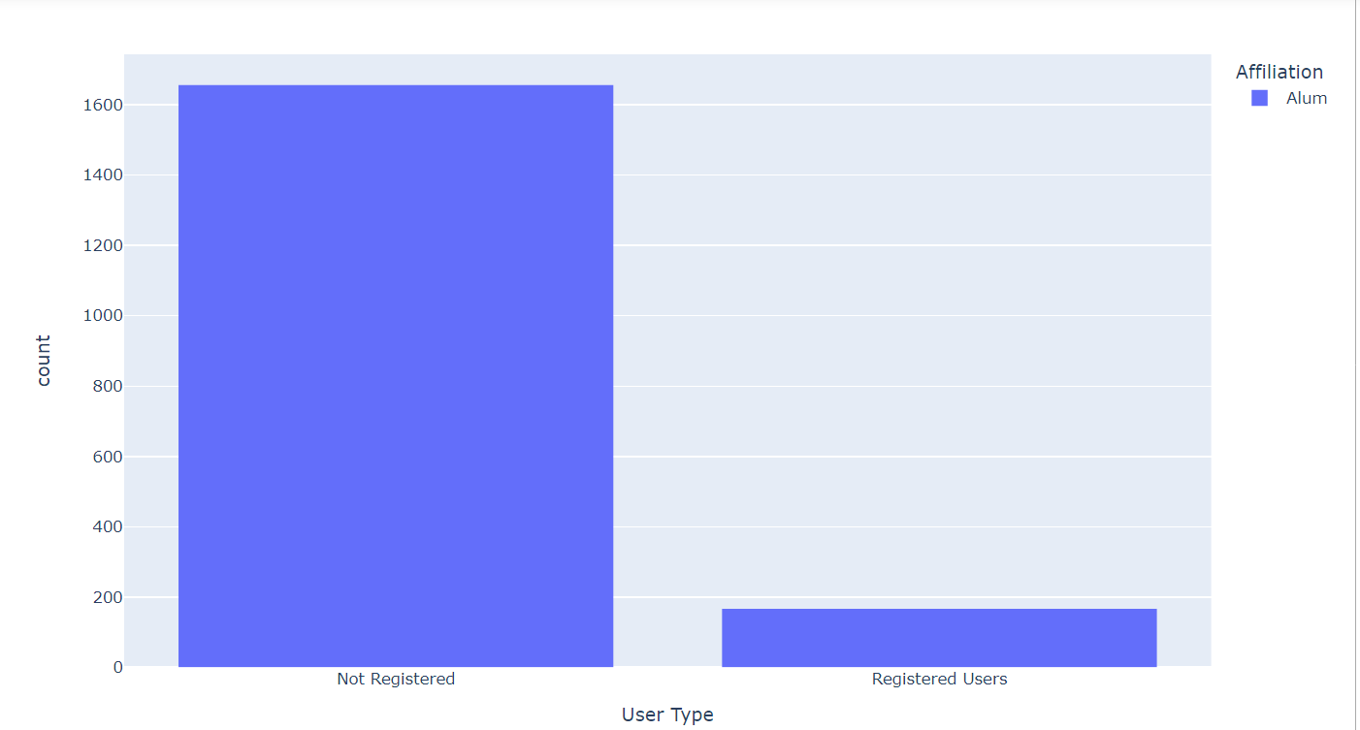
GMWS Connect Alumni Registration

Slide 3
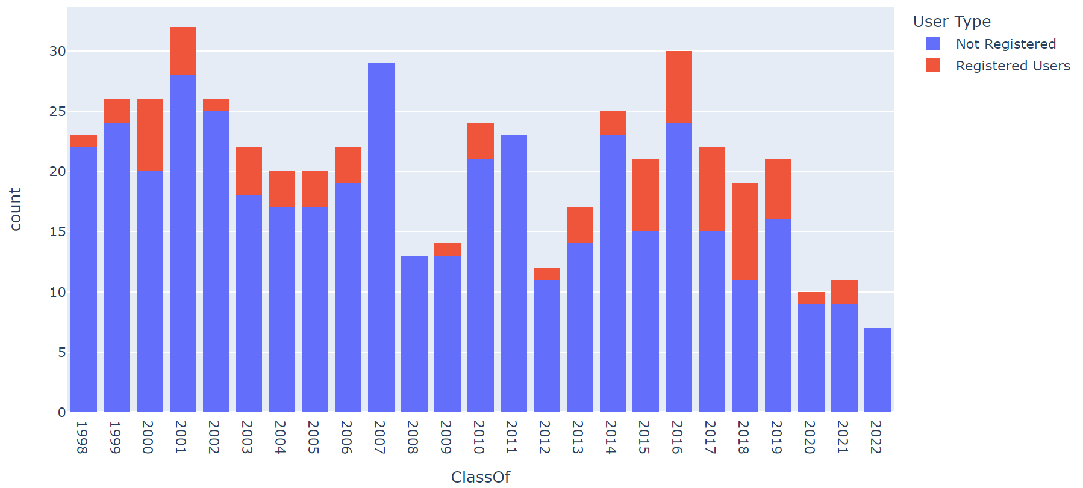
GMWS Graduates in Past 25 Years

Slide 4
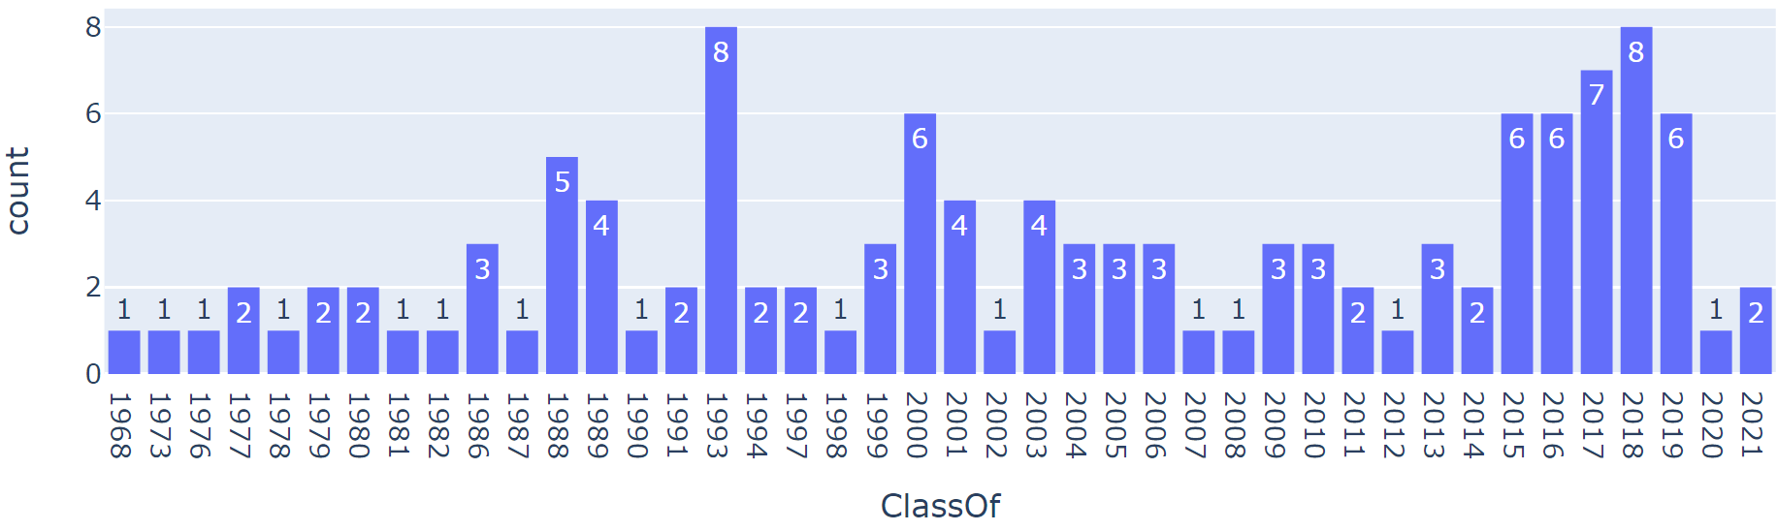

Registered GMWS Graduates by Year

Slide 5
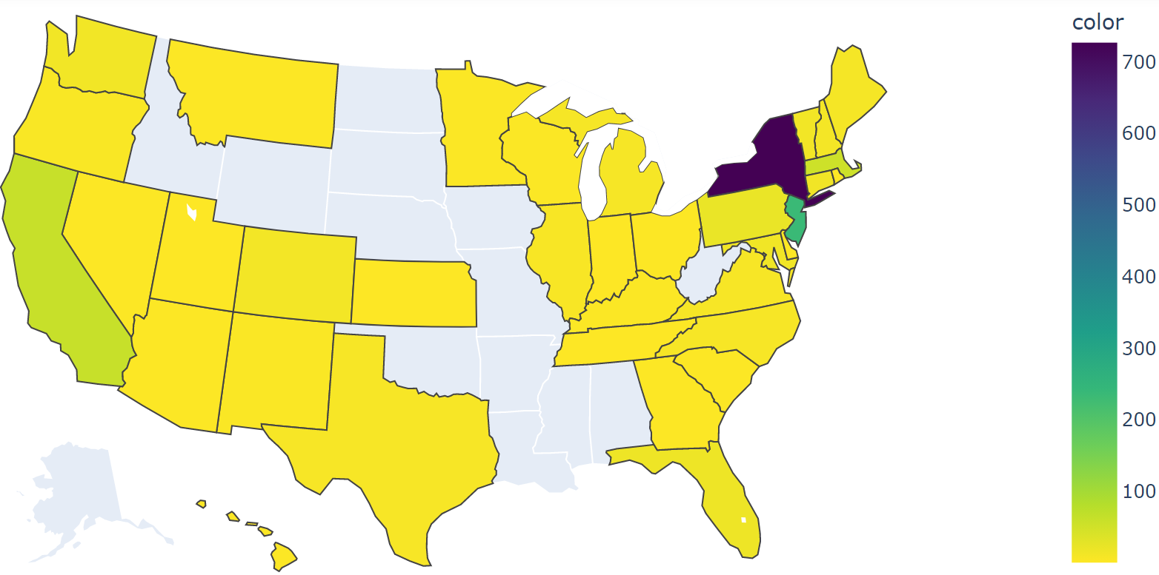
GMWS Graduates Distribution

Slide 6
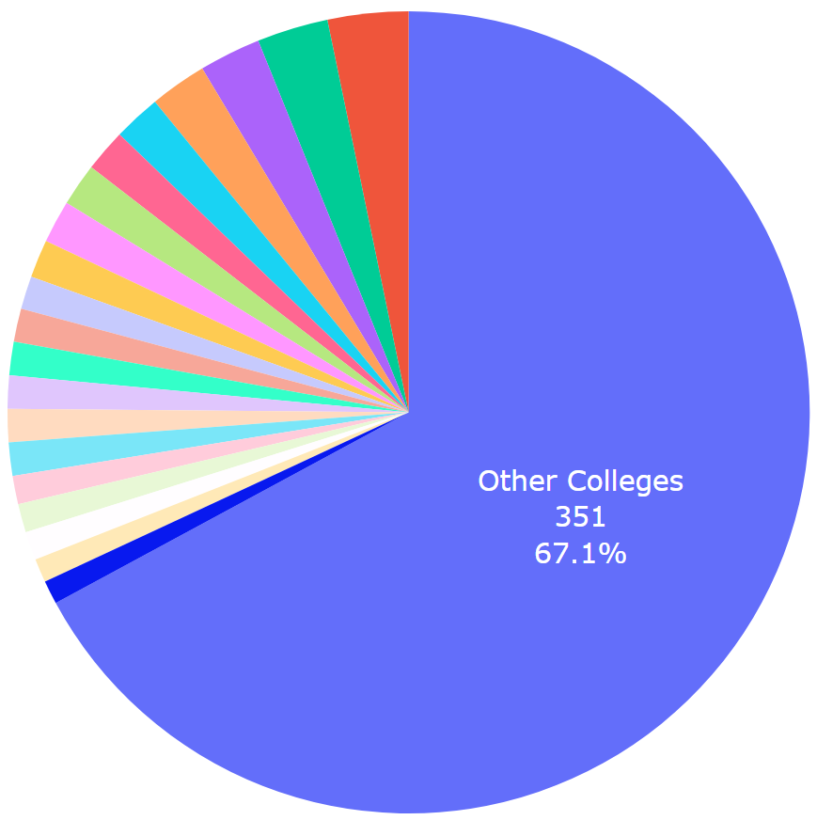
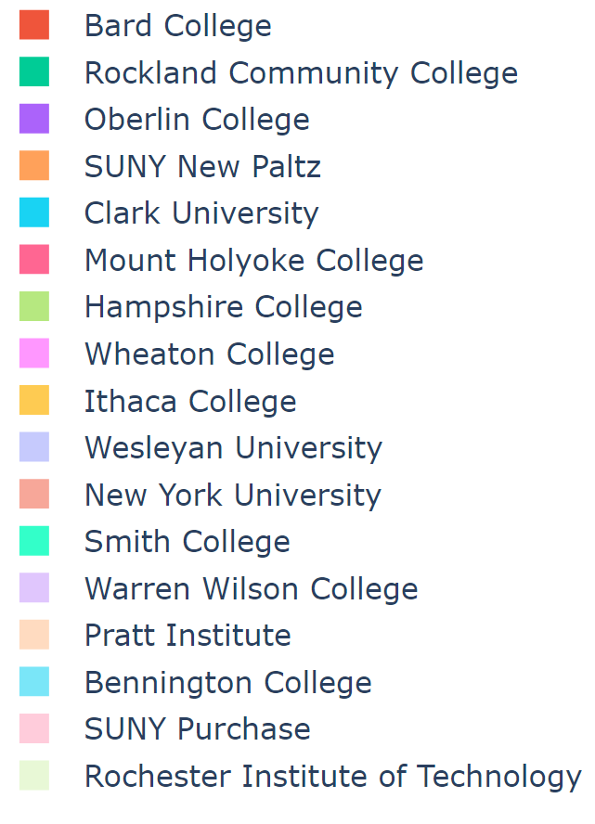
Where Did They Go?
(3.25%)
(2.87%)
(2.49%)
(2.29%)
(1.91%)
(1.72%)

Slide 7
Highly Ranked Colleges Alumni Went to
Yale University (1)
Cornell University (4)
Vanderbilt University (1)
University of California-Los Angeles (1)
New York University (6)
Emory University (1)
Wake Forest University (1)
Tufts University (5)
Swarthmore College (2)
Wellesley College (2)
Bowdoin College (1)
Middlebury College (1)
Dartmouth College (1)
Vassar College (6)
Wesleyan University (6)
Smith College (7)

Slide 8
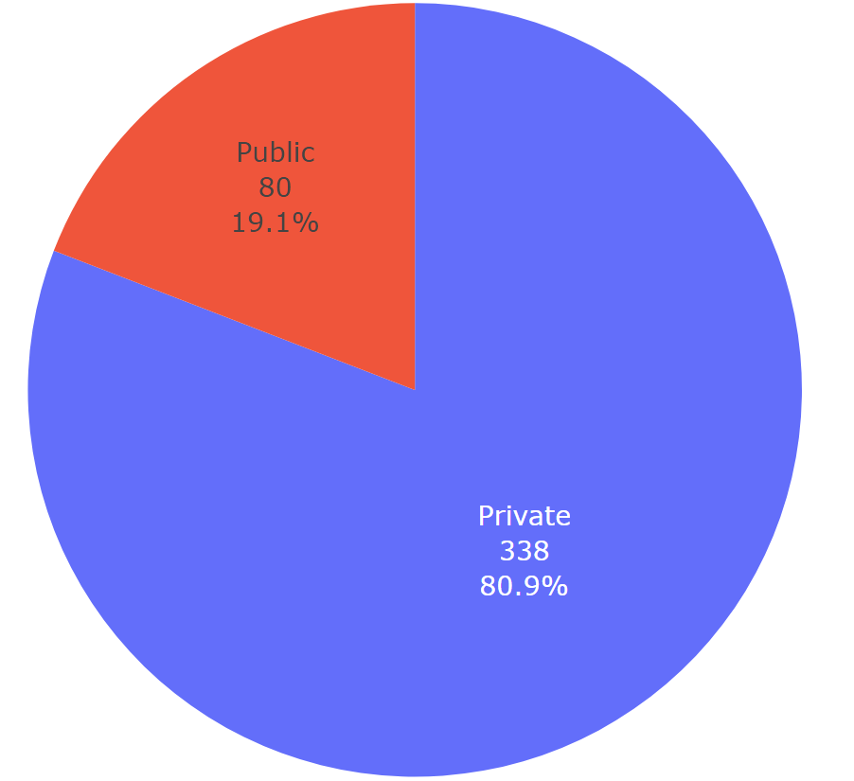
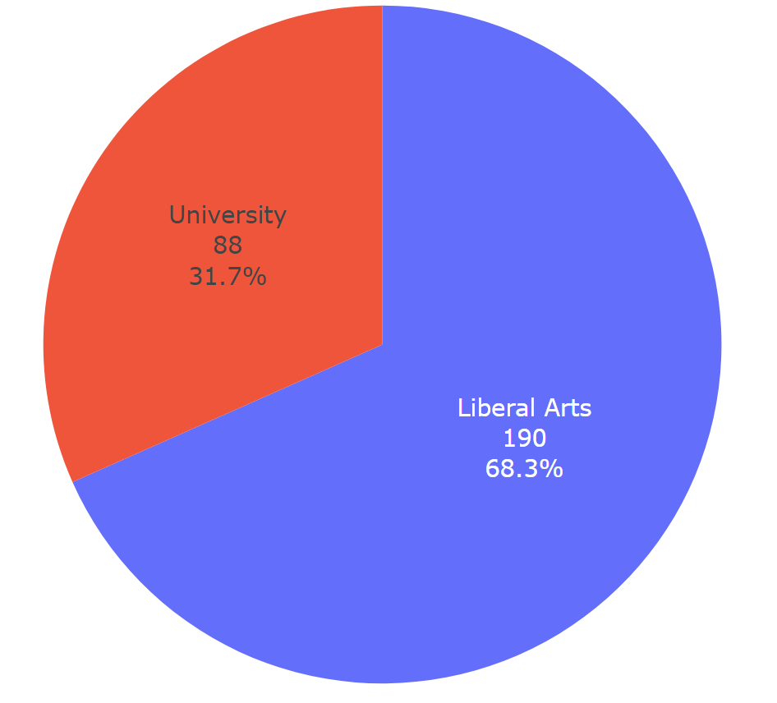
Private or Public?
Liberal Arts or University?

Slide 9
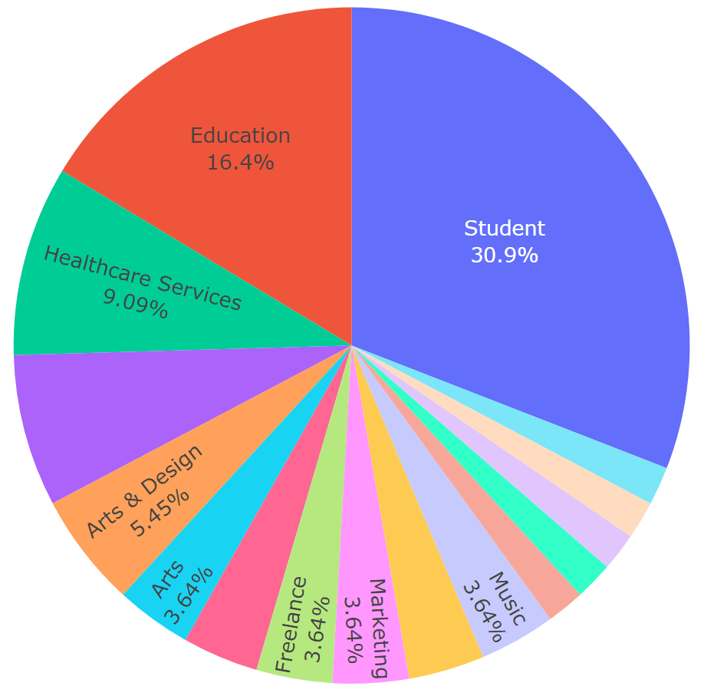
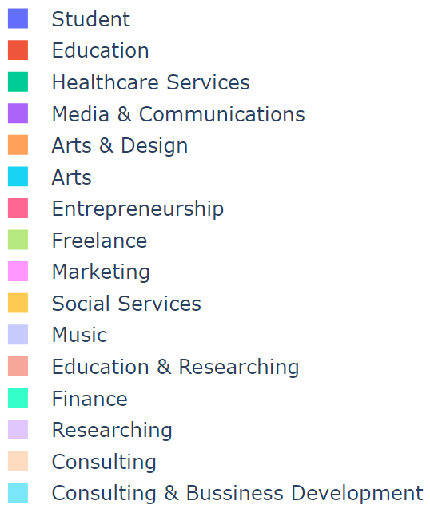
Profession and Occupation
Media & Communications
7.27%
Entrepreneurship
Social Services

